Slide 1
COE’s to R and V

Slide 2
COEs to R and V
Why?
Find R and V in Perifocal System
Convert Perifocal to IJK
Exercise

Slide 3
Why?
We want to be able to convert from COE’s to R and V because satellite tracking stations use R and V to determine where to point.
R and V is a good intermediate coordinate system to use to convert to other coordinate systems (e.g. elevation/azimuth and right ascension/declination.) These coordinate systems will become more important later.

Slide 4
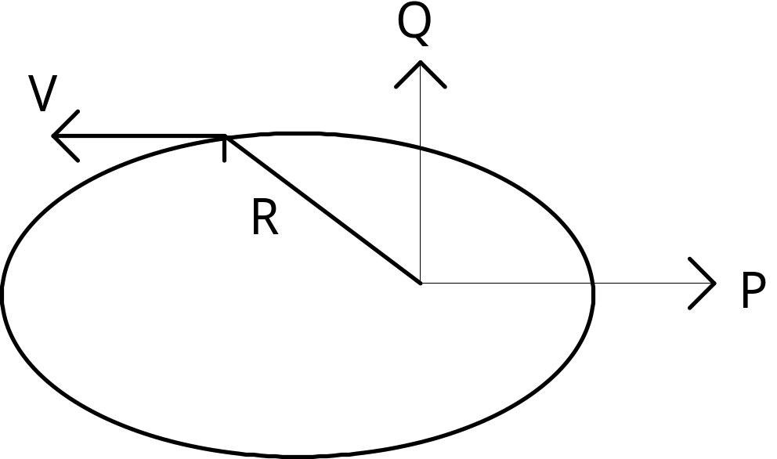
Perifocal Coordinate System (PQW)
Origin:
  Focus of Orbit
Fundamental Plane:
  Orbit Plane
Principle Direction:
  Periapsis
P:
  direction of periapsis
Q:
  90 deg from P in direction of satellite motion
W:
  PxQ (perpendicular to both P and Q)

Slide 5
Semi-latus Rectum
Define a new parameter p (semi-latus rectum)
This is not P from the coordinate system
We use this because it is defined for all orbits
For parabolas a=∞ and e=1, so a(1-e²) becomes ∞*0 (hard to compute, but p can be computed using other methods, p=h²/μ, see BMW pg 26)
It is the magnitude of the position vector when υ=90°
p = a(1-e²)
p

Slide 6

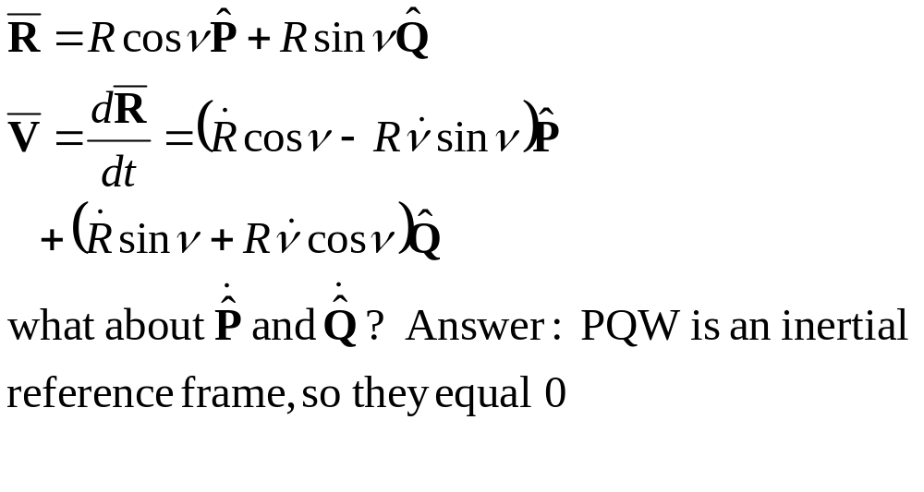


Express R and V in the PQW System
Rsinν
Rcosν

Slide 7
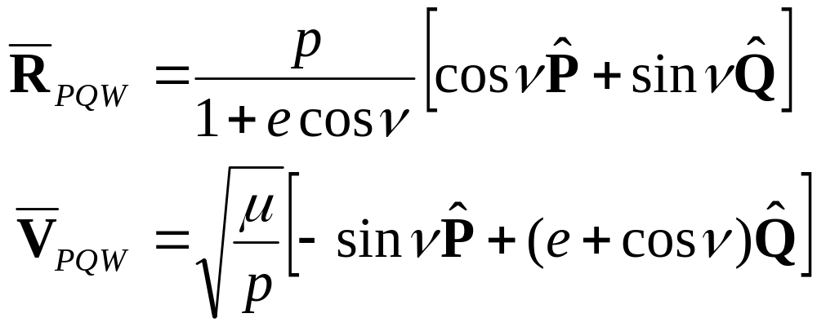
Express R and V in the PQW System
But the equations on the previous page are still in not expressed in terms of the COE’s. Using some relationships that we know about COE’s and R and V (BMW, pg 72 and at the end of these slides), we can reduce the previous equations to:
Why is there no W component in these equations?
Realize that this is not our end goal. This gives us R and V in the perifocal system, not the IJK form that we want.

Slide 8
Rotations
To get to the IJK frame from PQW we just need to do a couple of coordinate rotations
Let’s take a look at what those rotations are, and then review how we do that mathematically
Remember that when doing coordinate transformations the vector direction does not change, just the reference frame.

Slide 9






1st Rotation
The first rotation aligns the P vector with the ascending node vector
The P vector points to periapsis, so the angle between them is ω
The rotation is accomplished as a rotation about the 3rd axis (the W axis) with an amount of -ω

Slide 10



2nd Rotation
The second rotation aligns the W vector with the K vector
The W vector is perpendicular to the orbit plane, so the angle between them is i (or inclination)
The rotation is accomplished as a rotation about the 1st axis (the new P axis) with an amount of -i

Slide 11


3rd Rotation
The third rotation aligns the new P vector with the I vector (along with aligning the other two vectors as well)
The P vector now points to the ascending node, so the angle between it and the I vector is Ω
The rotation is accomplished as a rotation about the 3rd axis (the new W axis) with an amount of -Ω

Slide 12
Rotation Summary
So the rotation summary is:
  Rot3(-ω)
  Rot1(-i)
  Rot3(-Ω)
We do these sets of rotations for the R vector to get Rpqw to Rijk and then we use these three rotations again to get from Vpqw to Vijk
So how do we do this mathematically?

Slide 13
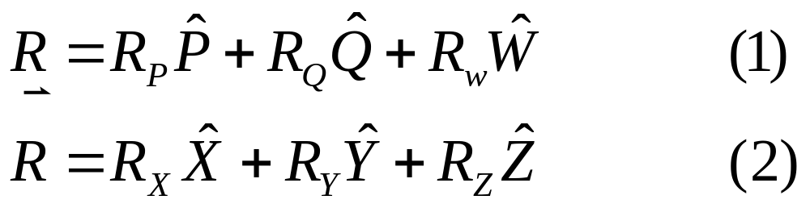










Rotations (the math)
1st Axis Rotation
α
α

Slide 14
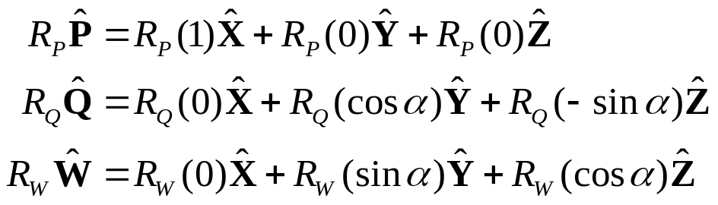
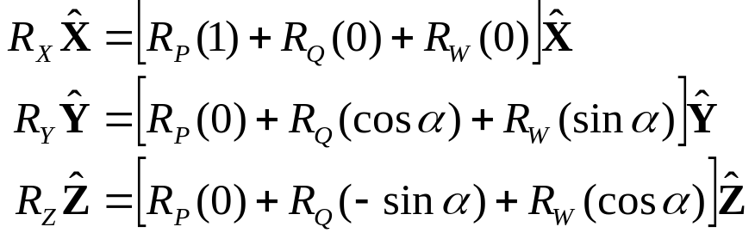
Rotations (the math)
1st Axis Rotation
From the picture to the right we get:
R_{W}sin(α)
Now plug them into equation (1) and equate that to equation (2) and we get:
α
R_{W}
R_{W}cos(α)
R_{Q}cos(α)
R_{Q}(-1)sin(α)
α
R_{Q}

Slide 15
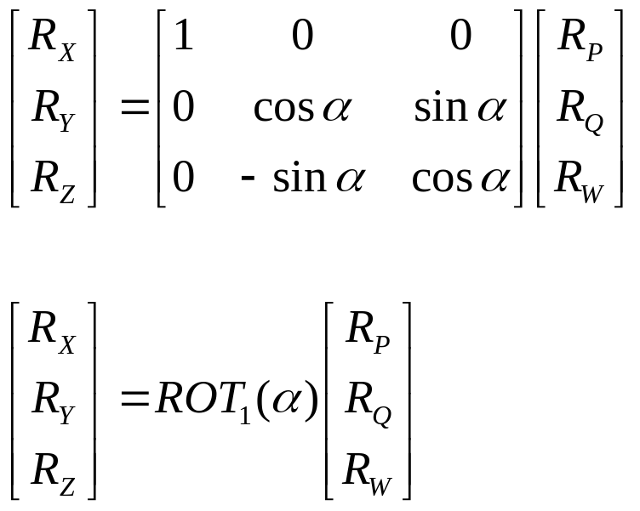
Rotations (the math)
1st Axis Rotation
Now put in matrix form:
α
α

Slide 16
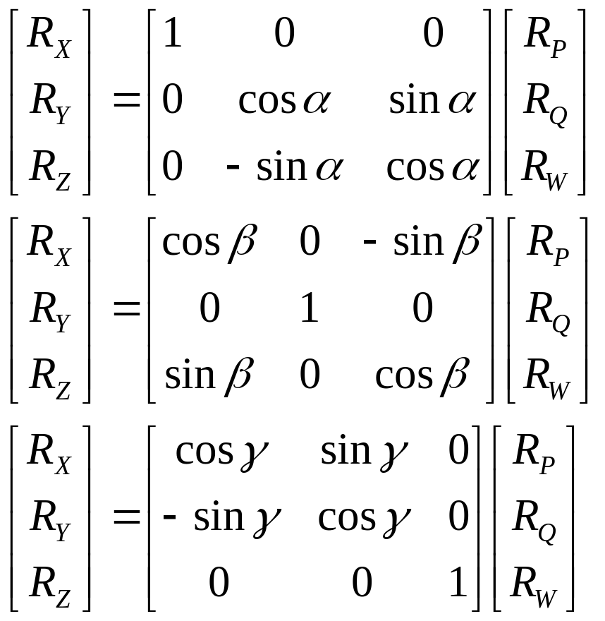
All 3 Rotation Matricies
We can derive the other two rotation matrices in a similar fashion.
On the right are the Rot1, Rot2 & Rot 3 matrices, respectively

Slide 17
Practicalities
Code up these three rotation matrices
Put all of them in one function:
    function B=axisrot(A,axis,alpha)
    A is the original vector
    B is the vector in the new reference frame
    axis is the axis to rotate around (1, 2 or 3)
    alpha is the amount to rotate (in radians)
  (don’t forget to test and document your routine)

Slide 18
Summary
Steps from COE’s to R and V
  Convert COE’s to R and V in PQW system
  Perform 3 rotations to get from PQW system to IJK system (Geocentric Equatorial)

Slide 19
References
Rotation matrix information can be found in “Fundamentals of Astrodynamics”, by Bate, Mueller and White, Section 2.6

Slide 20
What follows is the Derivation of R&V pqw

Slide 21
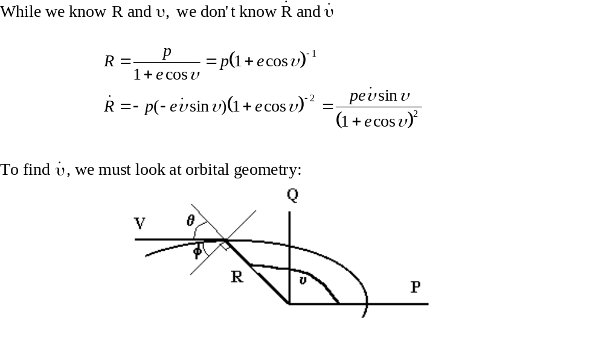
Derivation Details

Slide 22
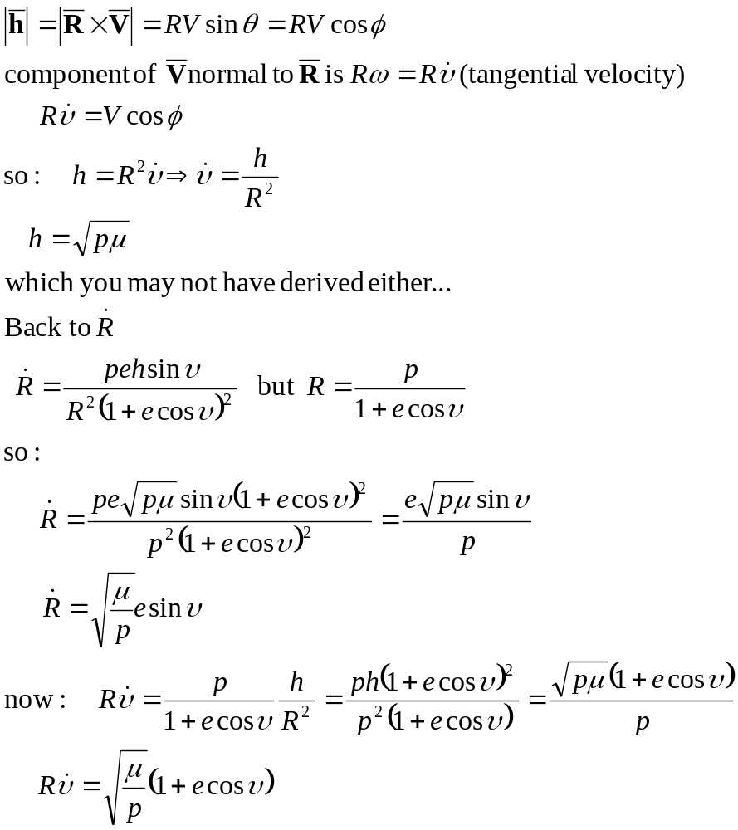
Derivation Details

Slide 23
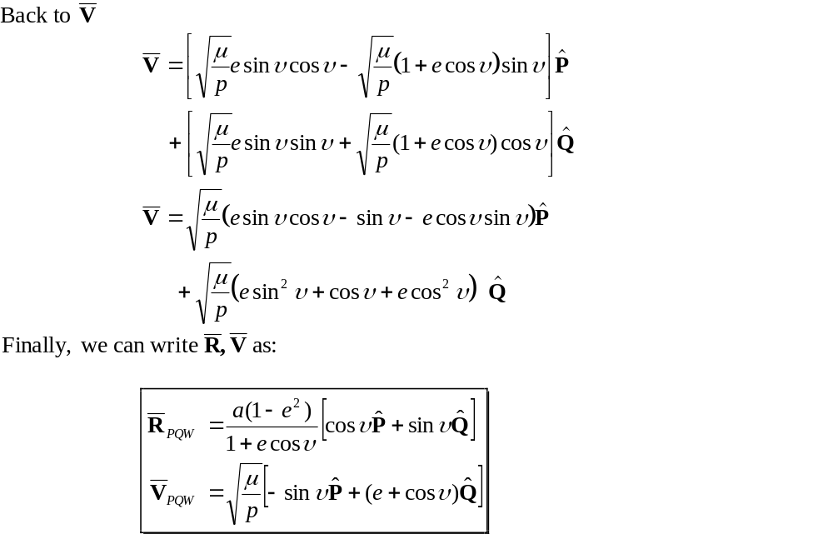
Derivation Details

